Slide 1

Inventory Transaction Report
*Data provided should be considered CONFIDENTIAL and PROPRIETARY*
©2011-2022 MNX Global Logistics. All rights reserved.
9/8/2022 4:02 AM
Print User : automation

Slide 2
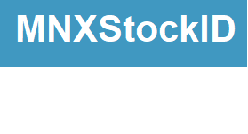
Inventory Transaction Report
*Data provided should be considered CONFIDENTIAL and PROPRIETARY*
©2011-2022 MNX Global Logistics. All rights reserved.
9/8/2022 4:02 AM
Print User : automation

